Slide 1
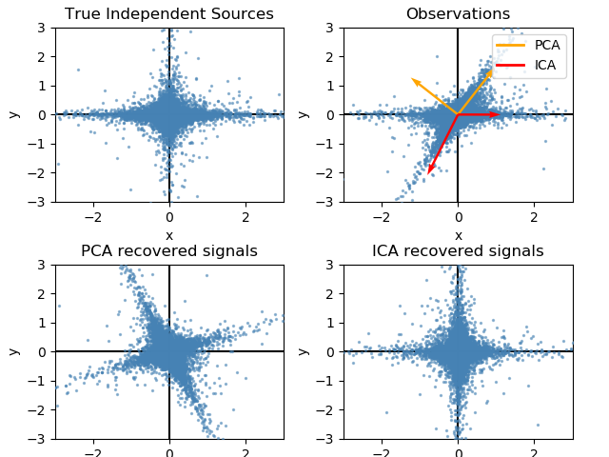


LEICA
Goal: find informationally optimal space to analyze dFC
Basis:
Seek space in which Shannon entropy is easily quantifiable
Ease of analysis requires minimum sufficient dimensionality
Notes:
The neuroimaging community has not yet found the optimal space in which to analyze dynamic functional connectivity. LEICA seeks to isolate this optimally informative space and use it to quantify dFC information content. It is expected that this optimal space will allow superior separation between conditions.
Starting basis: information theory
Seek to find space in which Shannon entropy of the whole brain is easily quantifiable
Know that entropies of multiple signals add linearly if and only if signals are statistically independent
Seek minimum sufficient dimensionality for this space
Thus, seek space in which:
Entropy of individual signals is easily quantifiable
Individual signals are statistically independent
All significantly informative dimensions are included
No uninformative dimensions are included

Slide 2

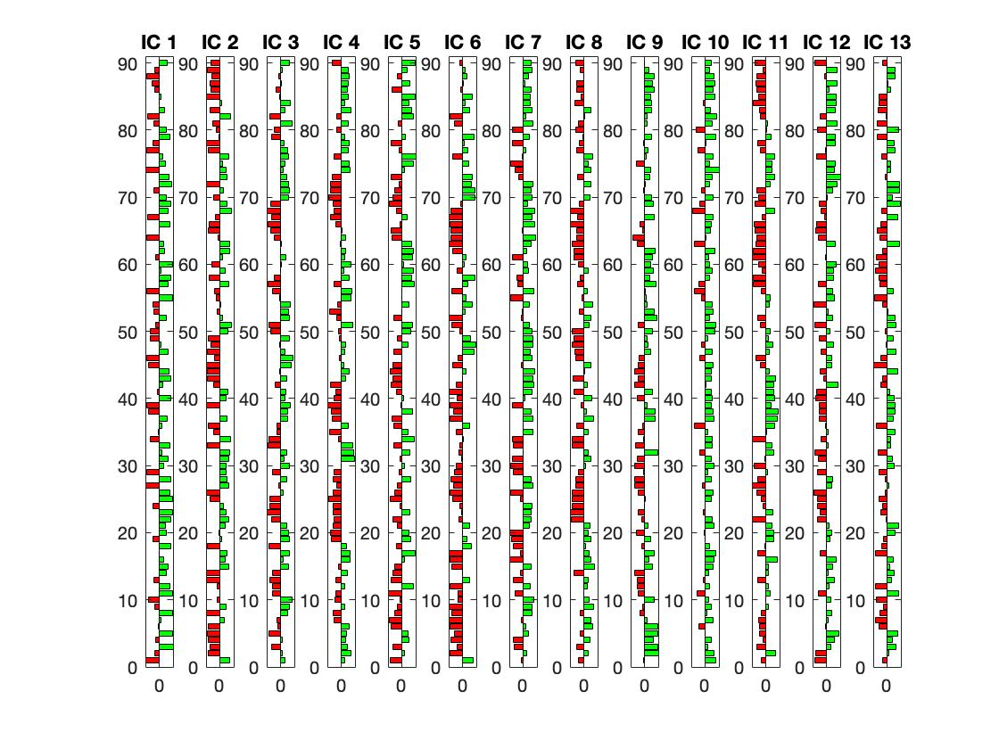
Pipeline
Compute dFC
Extract leading eigenvectors (LE) of dFC sample matrices
Convert LE’s into space-time matrix
Detect significant components with Marçenko-Pasteur distribution (Lopes-dos-Santos, Ribeiro, and Tort 2013)
Extract significant components and their activations with ICA
Figure 3, Lopes-dos-Santos, Ribeiro, and Tort 2013
Notes:
Compute phase-coherence dFC
Extract leading eigenvector of each dFC sample matrix
Convert leading eigenvectors into space-time matrix
Use Marçenko-Pasteur distribution (Lopes-dos-Santos et al. 2011; Lopes-dos-Santos, Ribeiro, and Tort 2013) to detect significantly informative components
Extract significantly informative components and their activation timeseries with ICA
Confirm that LEICA space provides superior separation between groups:
Using information-theoretic measures (entropy)
Using activation time series (BOLD, dFC)
Comparison between spaces (patient, control)

Slide 3
Results
LEICA more sensitive to entropy than MICA
LEICA more sensitive to component activation than ICA on dFC or z-scored BOLD
 | LEICA |  | MICA
 | p-values | Effect size | p-values | Effect size
CIC | 0.0228 | -0.5312 | 0.2045 | 0.2918
GIC, Controls | 9.999 * 10⁻⁵ | -1.8204 | 0.0172 | -0.5560
GIC, Patients | 0.1049 | 0.3710 | 9.999 * 10⁻⁵ | 1.1143
 | LEICA | ZICA | ICA
BOLD | 0/90 | 0/90 | 0/90
dFC | 72/90 | - | 3011/4005
CIC | 12/16 | 0/14 | 0/386
GIC, Control | 5/15 | 0/12 | 8/11
GIC, Patient | 11/17 | 0/14 | 7/11
Notes:
BOLD refers to the untransformed BOLD time series from the 90-region AAL ROIs
dFC refers to the dynamic functional connectivity generated from these BOLD signals
CIC refers to Common Independent Component space, i.e. the independent components found across all subjects.
GIC refers to Group Independent Component space, i.e. the independent components found across one group/condition. The following term describes which group the from which group the space has been generated.

Slide 4
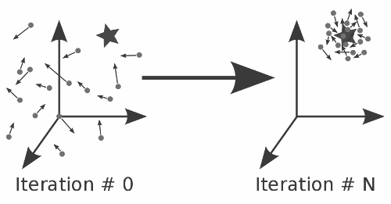
Model and Fit
Hopf bifurcation model
Fit with particle swarm algorithm
Each ”particle” represents one potential solution
Adjust particle directions, positions:
Continue until stopping criteria
Notes:
The previous studies have demonstrated that LEICA is highly sensitive to group-level differences in the Shannon entropy and dFC magnitudes. We intend to use this superior sensitivity to generate a dynamical model of healthy and medicated OCD brains, with the goal of extracting significant differences in working point and effective connectivity.
Utilize standard Hopf bifurcation model
Working point α = 0
Connectivity matrix C is standard 90-region AAL template
Cost function: Kolmogorov-Smirnov distance from simulated to empirical BOLD distribution
Fit with particle swarm algorithm:
Fit each subject individually
Use C as a prior to fit effective connectivity EC
Fit α for each region
Results:
No significant differences yet found.
Appears that
It is suspected that the current fit is not sufficiently precise.
Planned future modifications:
Fit α and EC separately
Use time-sensitive metrics to measure distances between empirical, simulated data:
Fourier decomposition/power spectrum
Matrix distance between empirical, simulation cross-spectra

Slide 5
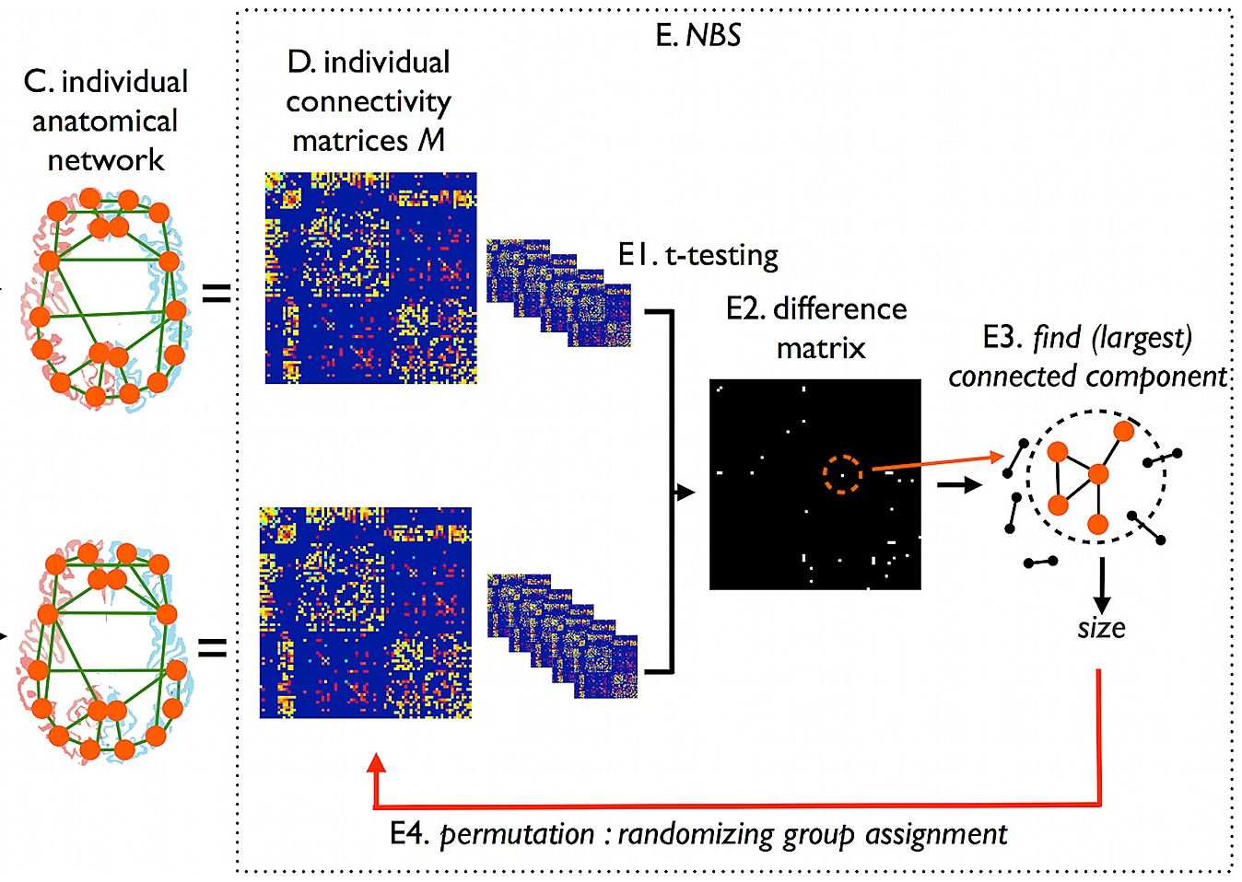
Model Results
Measure group-level EC differences with NBS
Current fit not precise enough
Plan to use time-sensitive data metrics in future:
Fourier decomposition/power spectrum
Matrix distance between empirical, simulation cross-spectra
EC
Notes:
The previous studies have demonstrated that LEICA is highly sensitive to group-level differences in the Shannon entropy and dFC magnitudes. We intend to use this superior sensitivity to generate a dynamical model of healthy and medicated OCD brains, with the goal of extracting significant differences in working point and effective connectivity.
Utilize standard Hopf bifurcation model
Working point α = 0
Connectivity matrix C is standard 90-region AAL template
Cost function: Kolmogorov-Smirnov distance from simulated to empirical BOLD distribution
Fit with particle swarm algorithm:
Fit each subject individually
Use C as a prior to fit effective connectivity EC
Fit α for each region
Results:
No significant differences yet found.
Appears that
It is suspected that the current fit is not sufficiently precise.
Planned future modifications:
Fit α and EC separately
Use time-sensitive metrics to measure distances between empirical, simulated data:
Fourier decomposition/power spectrum
Matrix distance between empirical, simulation cross-spectra

